Slide 1
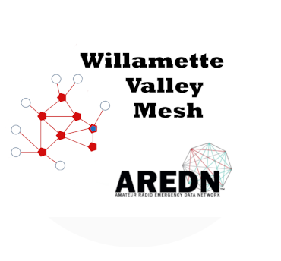
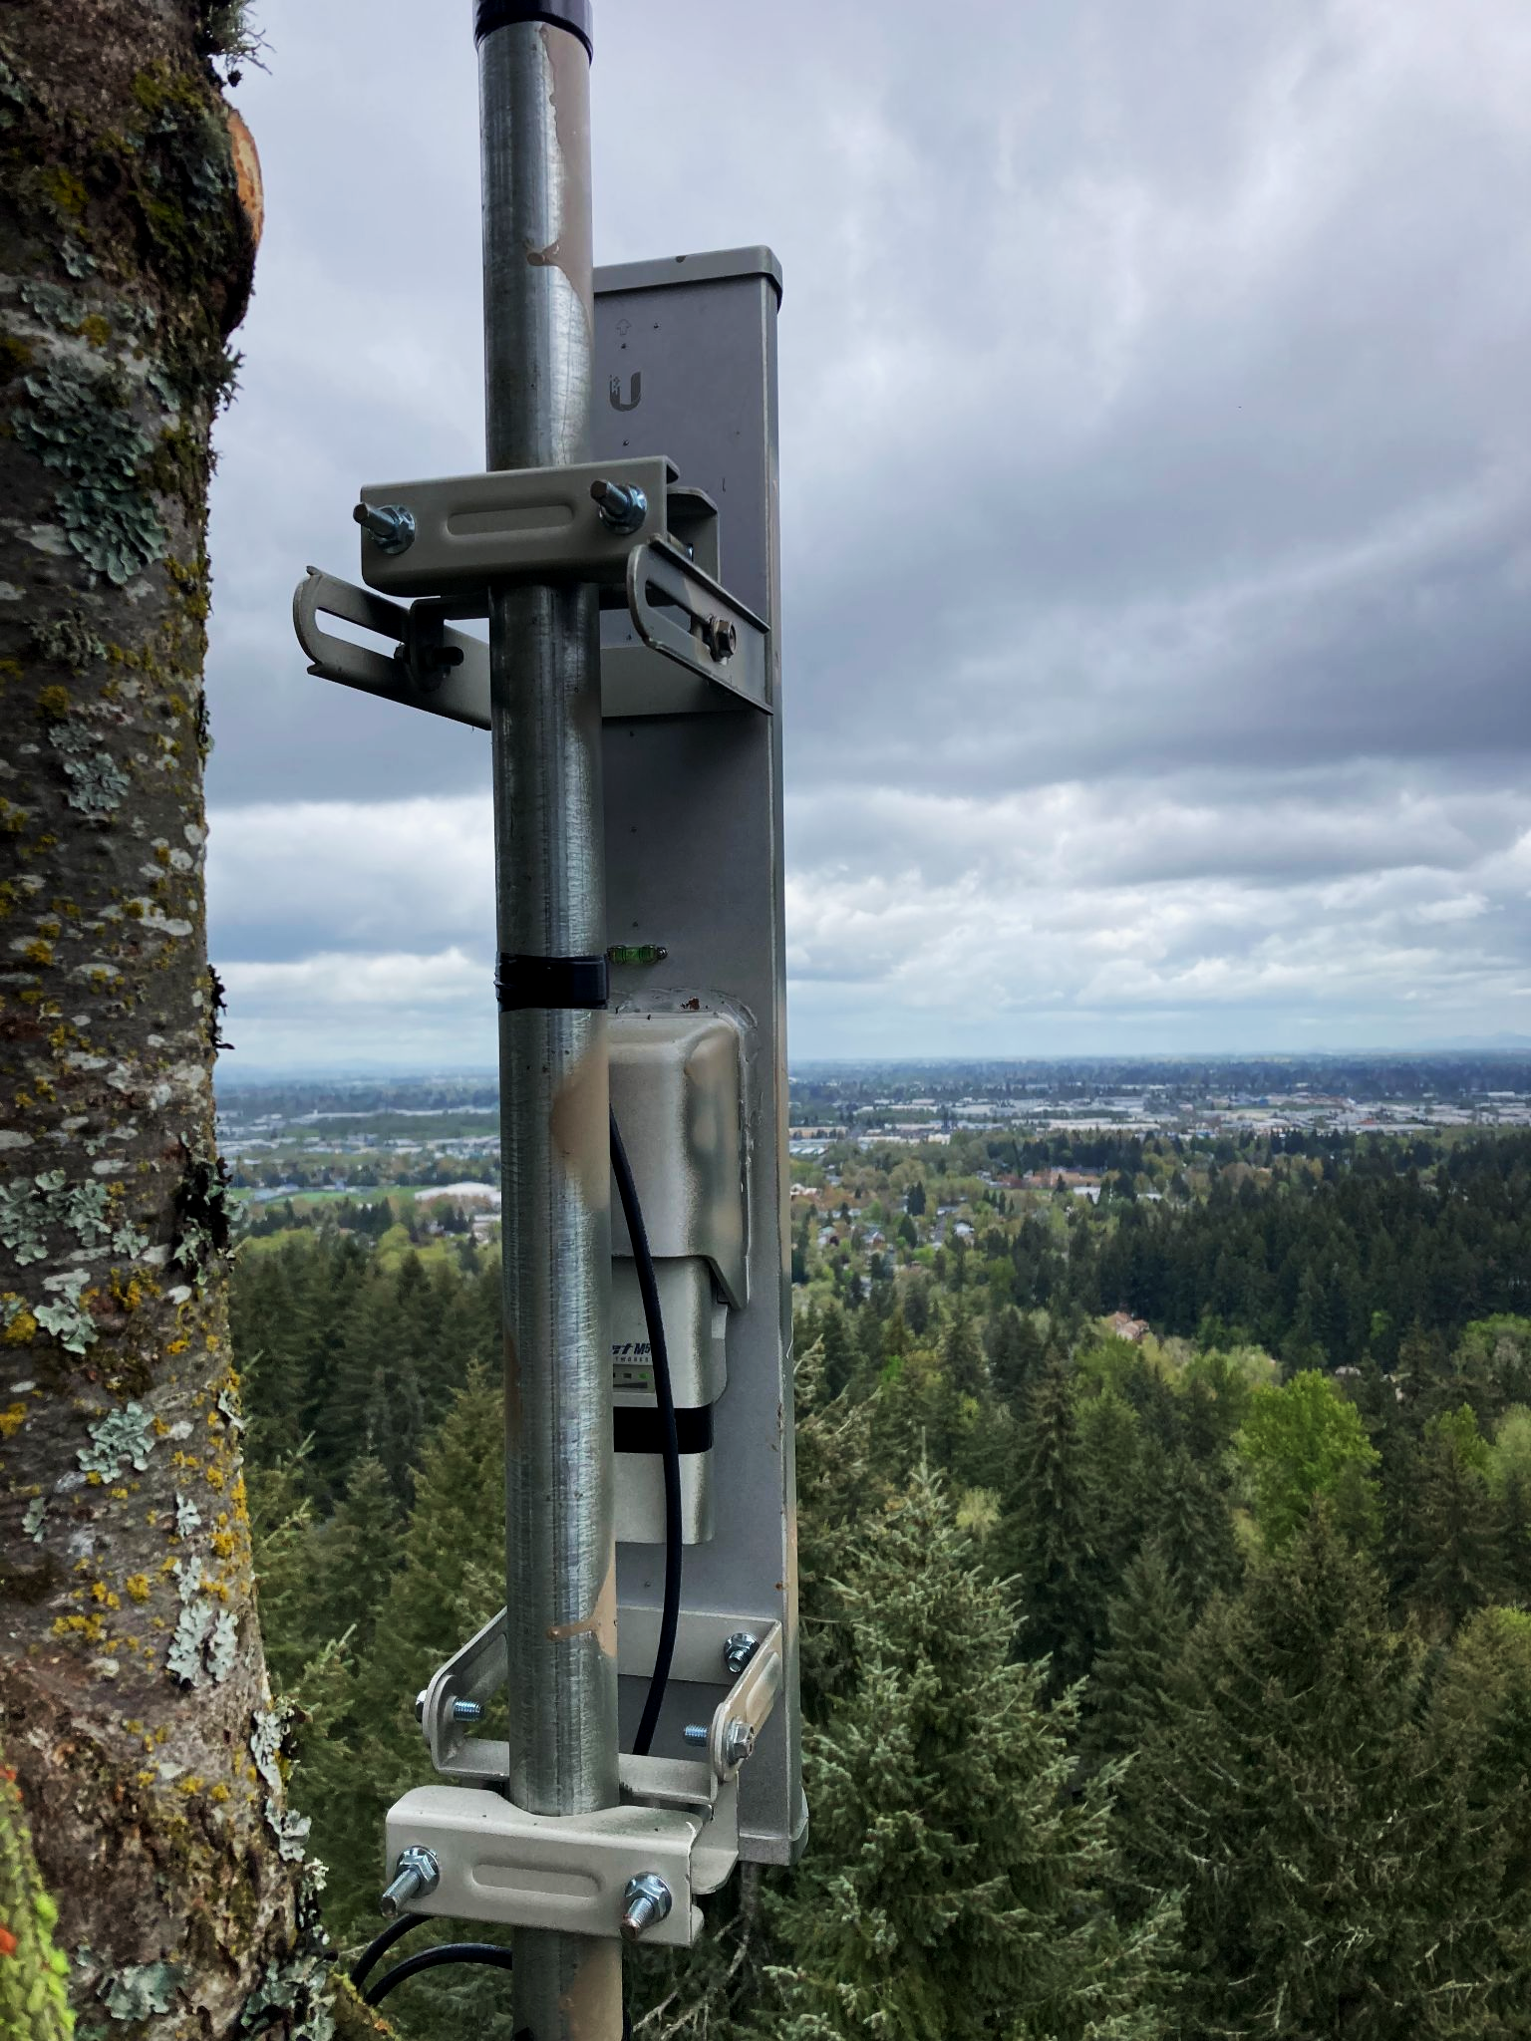
State of the Mesh
2023

Slide 2
State of the Mesh Agenda
Introduction: A Common Operating Picture
Where have we been?
Where are we now?
Where are we going?
SWOT
Smart Goals
Action Plan

Slide 3
Where have we been?-Objectives
Provide our community high speed emergency communications using a wireless local area network based on the AREDN amateur radio mesh protocol.
Combine Mobile Ad Hoc Networking with home and tower based stations to achieve connections among amateur radio operators, served emergency response agencies and community partners.
Provide rapid transfer of forms, email and imaging to improve situational awareness and resource allocation.

Slide 4
Where have we been?
Amateur Radio Communications Emergency Operations principles:
Interoperable communications-use what works (AREDN)
Connect with neighboring counties (join forces, support)
Find and utilize local talent, and equipment (use what you have)
Priority links to operators and install working services immediately
Field test equipment and coverage
No single served agency controls the system or owns the devices
Share what we know to help others succeed
Use Part 97 rules. Don’t share your WAN.
Use the mesh to investigate shared computing services-fun and useful

Slide 5
Where are we now?
370 nodes -> 638 devices -> 1077 RF miles
Working network across 16 counties (Oregon and S. WA)
370 AREDN nodes
148 Unique Callsigns (node operators)
Milestones:
Rapid growth- We had 293 nodes in July 2022.
Mikrotik AREDN equipment from ARDC Mesh Grant distributed to many groups and individuals.
New installations on St Vincent’s Hospital, Livingston Mtn, Terwilliger Plaza connecting Washington, Clark (WA), Multnomah, Yamhill, and Clackamas Counties.

Slide 6
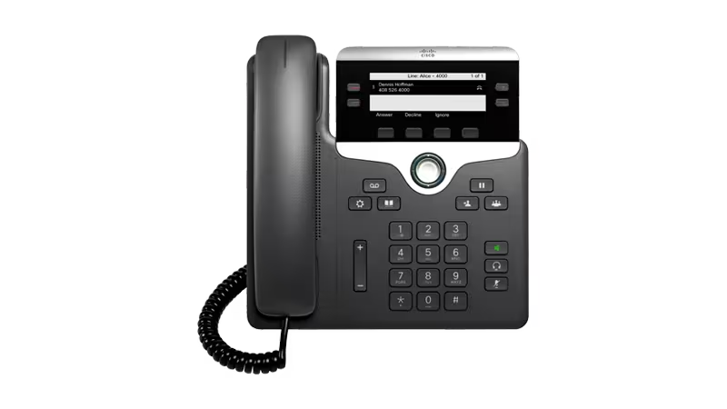
VoIP Services
57 IP Phones on the mesh!
11 MeshPhone Offices Serving:
Multnomah, Clackamas, Marion, E. Lane, W. Lane, Jackson, Josephine, Polk, Yamhill, Washington, & Clatsop
Inter-operates with: PSTN, Hamshack Hotline, Etc.
Permits dialing by DMR ID and Callsign
Four AllStar linked repeater sites

Slide 7
File Services
Variety of File Servers
Tiny File Manager, NextCloud, Samba, File Gator, Citadel, Apache & NGINX Web Servers
Public Mirrored Folders:
https://sites.willamettevalleymesh.net/CALLSIGN/

Slide 8
Email/Chat Services
RMS Servers
Yamhill, Lane, Marion, Linn
Winlink Express over AREDN
ICS forms. Interoperable communications. Peer to Peer.
Mesh Chat
Real-Time. Synchronized across the mesh.

Slide 9
Collaboration Services
Citadel BBS
File, email, chat, calendar, etc.
NextCloud - Real Time Shared Editing
Files, Documents, Spreadsheets, Presentations, Chat
Packet Bulletin Boards
Messaging, Winlink, Analog Packet Interface (BPQ32)

Slide 10
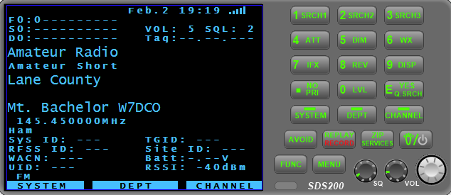
Utility and Reference Features
Live Mesh Map and Mesh Info
NTP servers
AllStar repeater linking
IP Video Cameras
Wikipedia (Full Text)
iPerfspeed speed testing
nMap and ZenMap network topology tools
APRS-IS Servers & APRS Live Mapping
Topology, and Stranded Node Maps
Uniden Radio Scanner - Audio Stream

Slide 11
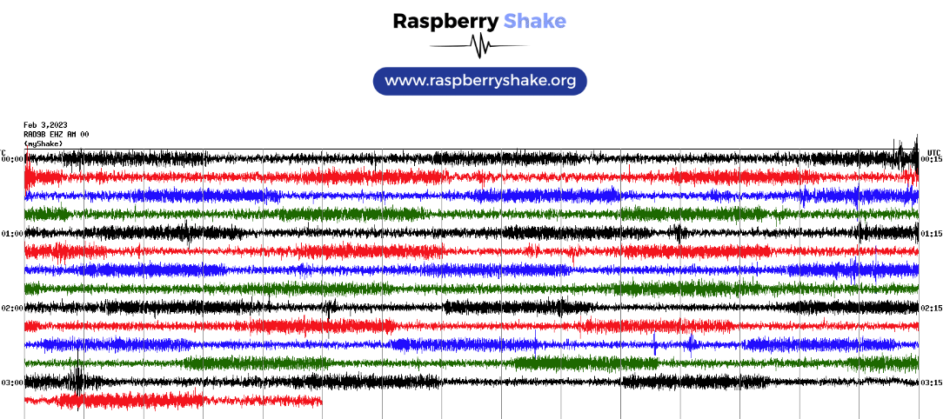
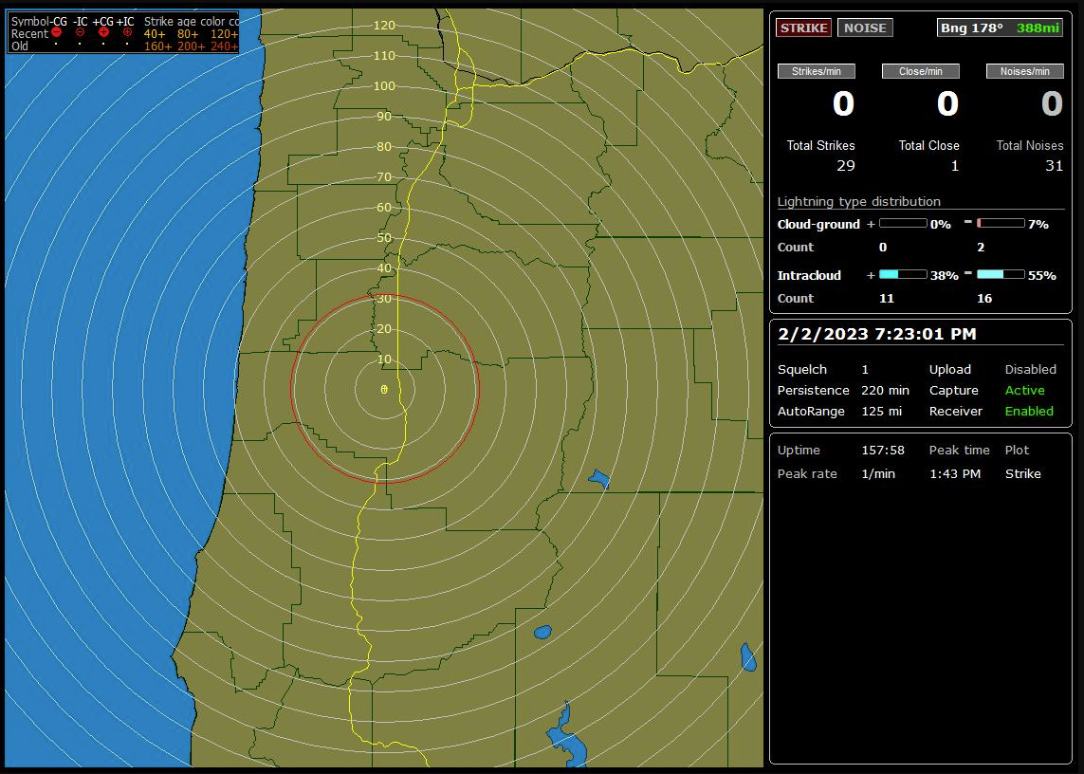
Experimental & Promotional services
Local WX Stations
ADS-B Plane Tracker
Weather Balloon Tracker
Minecraft Server
Webcams
Misc. Information Pages
Lightning Detector
Seismograph

Slide 12
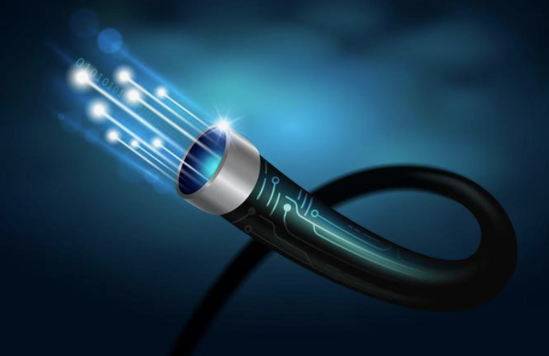
New Technology
LCOG Super Switching Center
Using ProxMox Virtual Machines
Linking Eugene to Florence over Fiber Optic
Coordinated Radio Location
Telemetry. Power management. Mesh health and status.
MeshPhone w/ Long Distance Calling

Slide 13
Opportunity for Engagement
All Hands AREDN Meeting at Ham Fest
Quarterly MeshPhone Zoom Meetings
WVMN & MeshPhone Sysop Groups.IO
Forming Mesh Management Teams and Subject Matter Experts
Identifying Functions (grants, outreach, coordination, technical, installation)
Building Community (site identification, expansion, govt. liaisons)
Coordinated Radio Location
Telemetry. Power management. Mesh health and status.
MeshPhone w/ Long Distance Calling

Slide 14
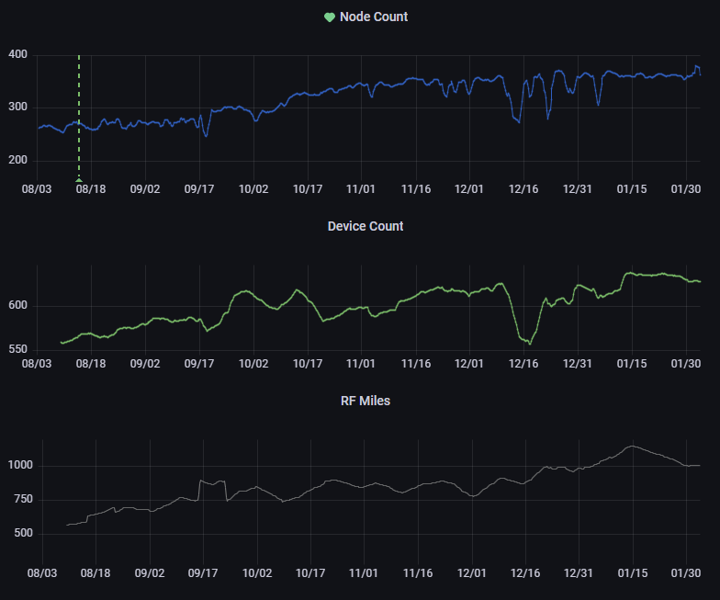
Historic Mesh Growth

Slide 15
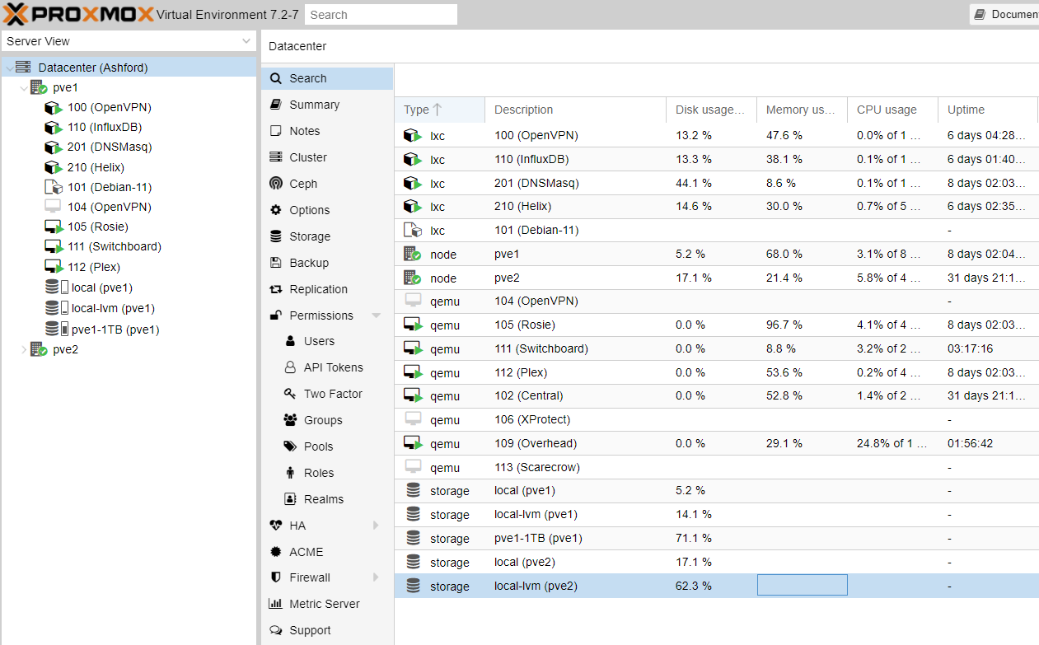
ProxMox Virtual Environment

Slide 16
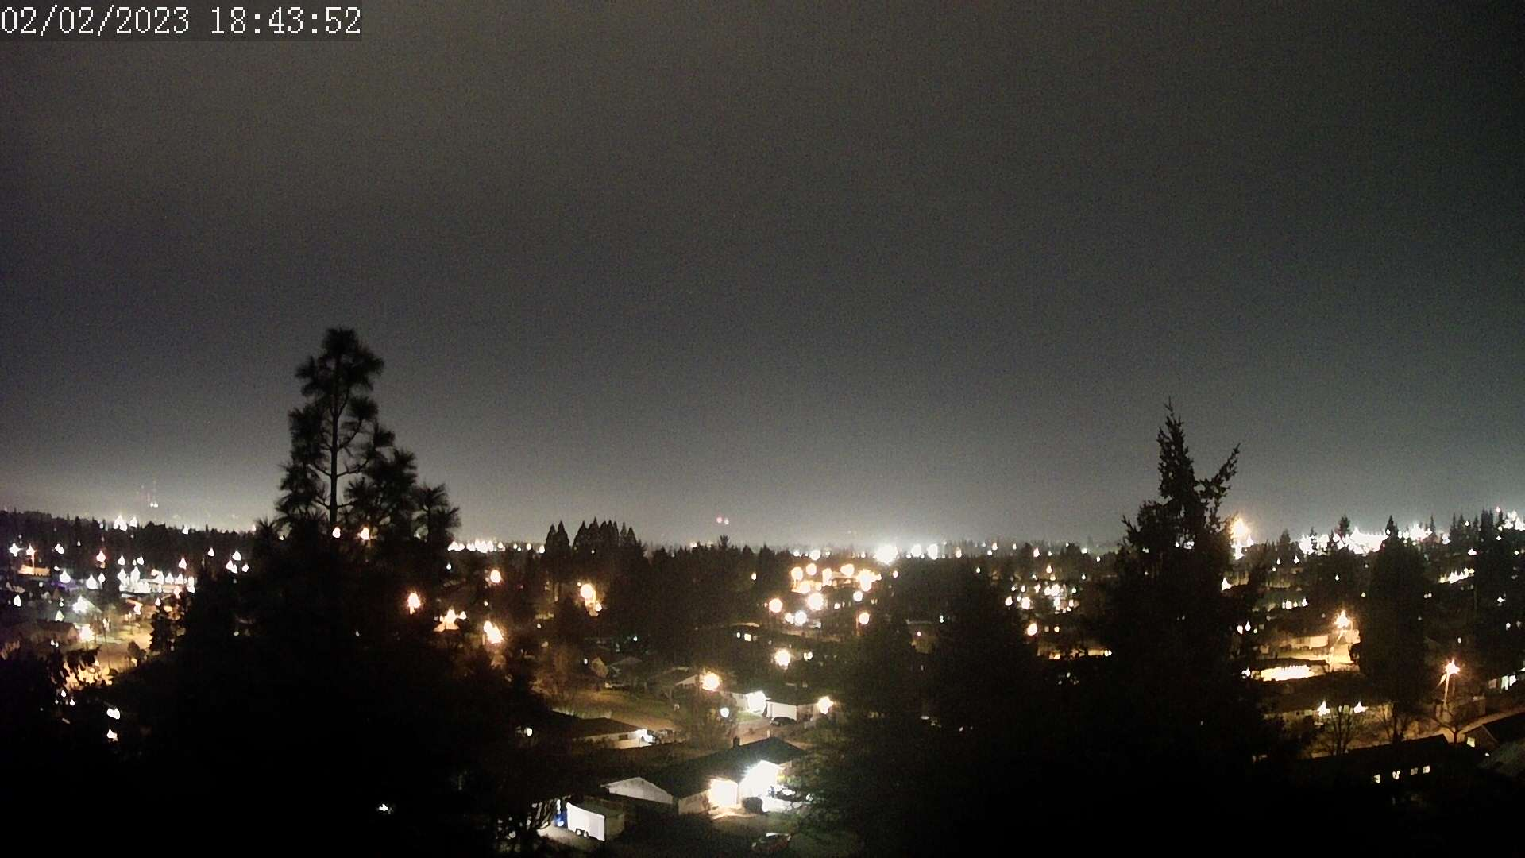
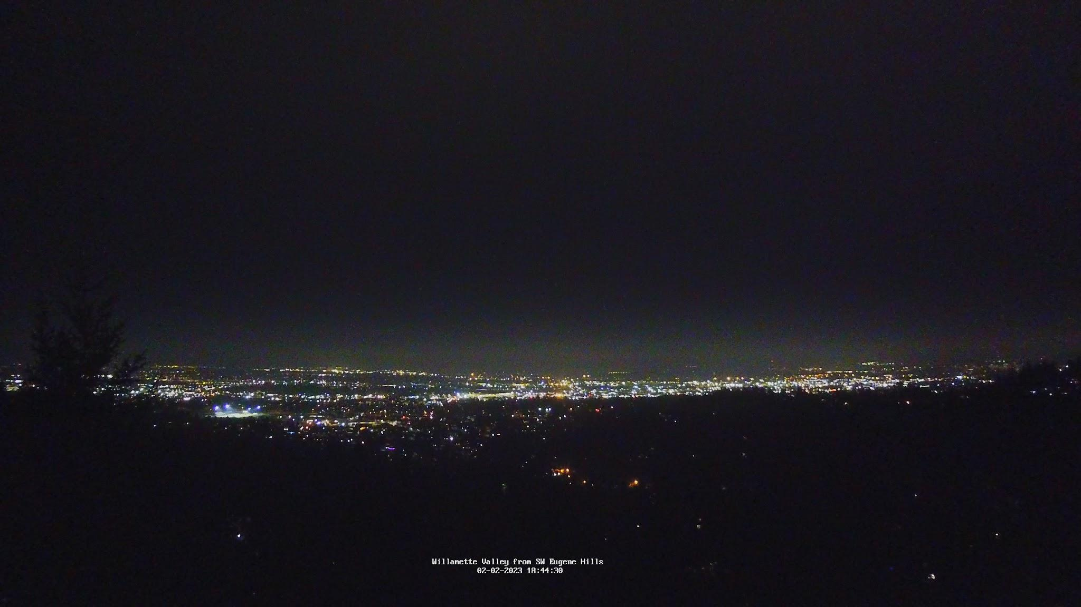
WebCams
KC7RJK
AI7BQ

Slide 17
Questions and Links?
Website: https://willamettevalleymesh.net/
Groups.io: https://groups.io/g/WVMN

